Slide 1
Offline Bengali Handwritten Sentence Recognition using BiLSTM and CTC Networks
Paper ID
111
Authors:
M. A. Muhaimin Sakib
Chittagong University of Engineering & Technology
Omar Sharif
Chittagong University of Engineering & Technology
Mohammed Moshiul Hoque
Chittagong University of Engineering & Technology
Presented by
M. A. Muhaimin Sakib
5th International Conference on Internet of Things and Connected Technologies (ICIoTCT) 2020

Slide 2
Contents
Introduction
Motivation
Contribution
Related Work
Proposed Framework
  Preprocessing and Segmentation
  Feature Extraction
  BiLSTM Network
  CTC Layer
Results and Analysis
Conclusion
5th International Conference on Internet of Things and Connected Technologies (ICIoTCT) 2020

Slide 3
Introduction
Handwriting recognition is the ability of a computer to understand & translate handwritten text into digital form or data.
Approaches:
    Online
    Offline (Our concern: Offline handwriting recognition)
Online handwriting recognition involves the automatic conversion of text as it is written on a special digitizer, where a sensor picks up the pen-tip movements.
Offline handwriting detection is a process of detecting handwriting where someone writes something on a piece of paper,
- handwritten text is then scanned
- processed for recognition.
5th International Conference on Internet of Things and Connected Technologies (ICIoTCT) 2020

Slide 4
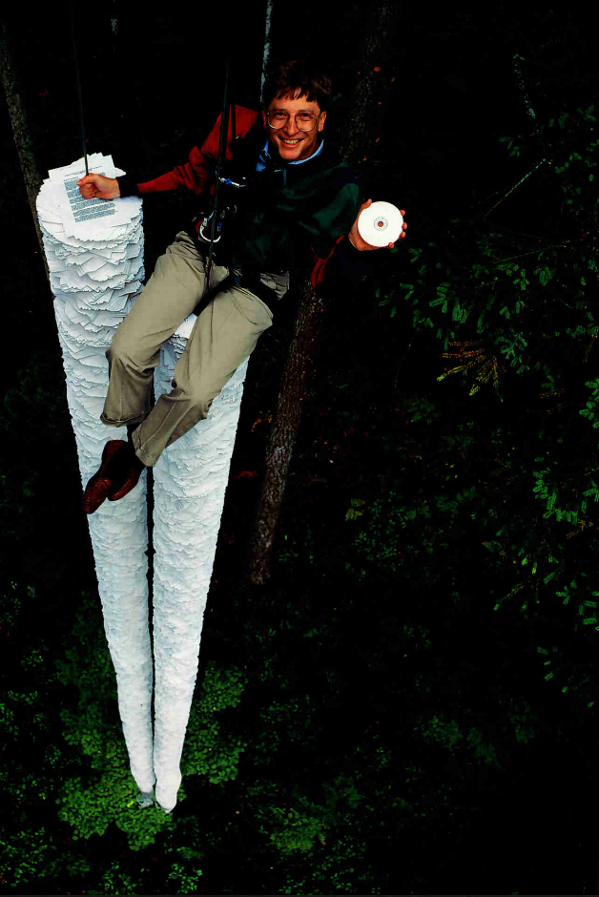
Motivation
Handwritten documents takes up more physical space & they are difficult to make copies of.
A lot of important knowledge gets lost or does not get reviewed because of the fact that they never got backed up in digital format.
A lot of advancements have been made regarding English language but not so much for Bangla.
Historically/Nationally important documents/records can be archived permanently in digital form, & used effectively for other purpose.
5th International Conference on Internet of Things and Connected Technologies (ICIoTCT) 2020

Slide 5
Contributions
Develop a system that can recognize offline handwritten Bangla sentence & produce a computerized text sentence as output.
Develop a dataset consisting of 450 bangla handwritten sentences & 1395 handwritten words with 15 different writing styles.
Evaluate the system with different sentence lengths & various writing styles in offline mode.
5th International Conference on Internet of Things and Connected Technologies (ICIoTCT) 2020

Slide 6
Related Work
 | Handwritten Bangla Digit Recognition Using Deep Learning (M. Z. Alom et al. , 2017) | Bangla handwritten character recognition using deep belief network. (M. M. R. Sazal et al. , 2014) | A fuzzy features based online handwritten Bangla word recognition framework. (K. Chowdhury et al. , 2015)
Work done | Introduced Bangla digit recognition techniques based on Deep Belief Network (DBN) and various Convolutional Neural Networks (CNN) architectures. | Employed the deep belief network (DBN) to recognize Bangla handwritten character. Used both supervised and unsupervised learning. | Used fuzzy linguistic rules in order to recognize Online Bangla handwritten words. Evaluated results for various writing styles
Limitations | Limited to only recognizing handwritten bangla digits. | Unable to recognize handwritten words or sentences. | Unable to recognise handwritten bangla sentences.
All existing approaches are either limited to digit, character or word level recognition. No meaningful research has been conducted yet for Bengali handwritten sentence recognition.
5th International Conference on Internet of Things and Connected Technologies (ICIoTCT) 2020

Slide 7
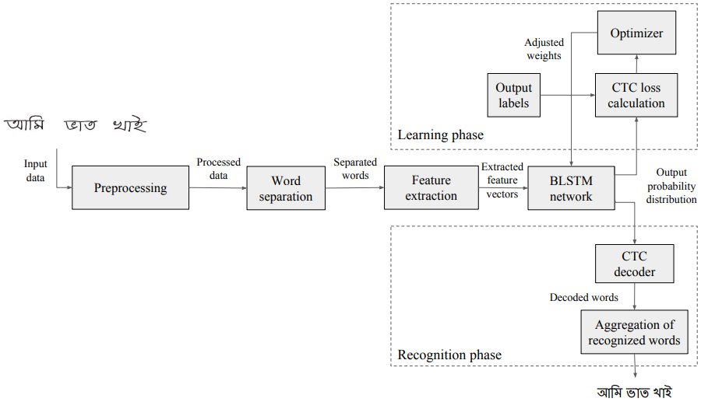
Proposed Framework
Fig 1: Proposed framework for handwritten sentence recognition.
5th International Conference on Internet of Things and Connected Technologies (ICIoTCT) 2020

Slide 8

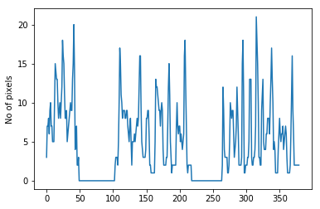
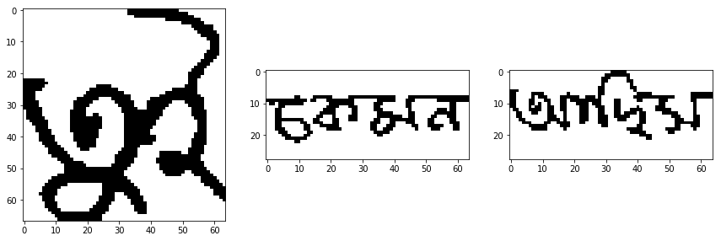
Preprocessing & Segmentation
The image containing handwritten text is at first preprocessed into a binary image.
After binarizing the sentence image, it is segmented into constituent word images.
Fig 2: Segmentation process
5th International Conference on Internet of Things and Connected Technologies (ICIoTCT) 2020

Slide 9
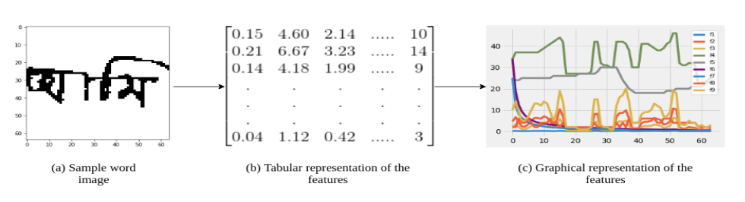
Feature Extraction
After segmentation, features are extracted from each word image.
A sliding window of width 1 pixel was used to extract 9 geometrical features at each window position along the width of the image.
The features hold information about how the black pixels are distributed throughout the window.
Fig 3: Feature extraction process.
5th International Conference on Internet of Things and Connected Technologies (ICIoTCT) 2020

Slide 10
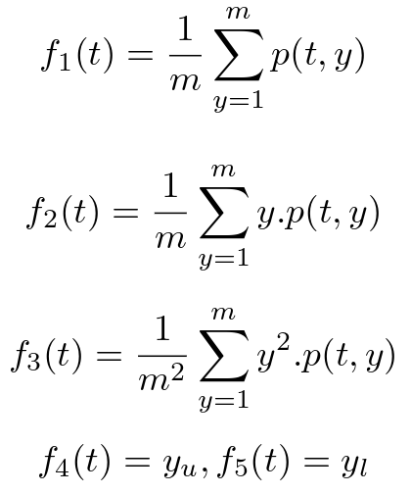
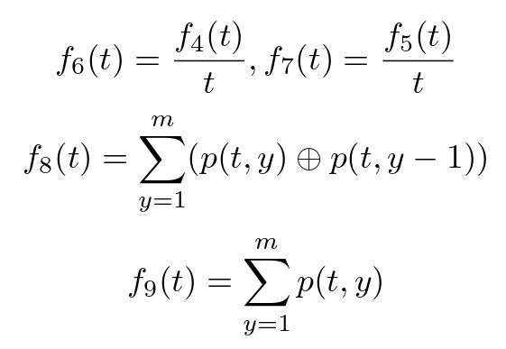
Feature Extraction (Contd.)
The mean number of black pixels at each window position.
The center of gravity of the pixels.
The second-order vertical moment of the center of gravity.
The position of the lowermost & uppermost black pixels.
The gradient of uppermost & lowermost black pixels.
Number of black-white transitions
Number of black pixels inside the window.
5th International Conference on Internet of Things and Connected Technologies (ICIoTCT) 2020

Slide 11
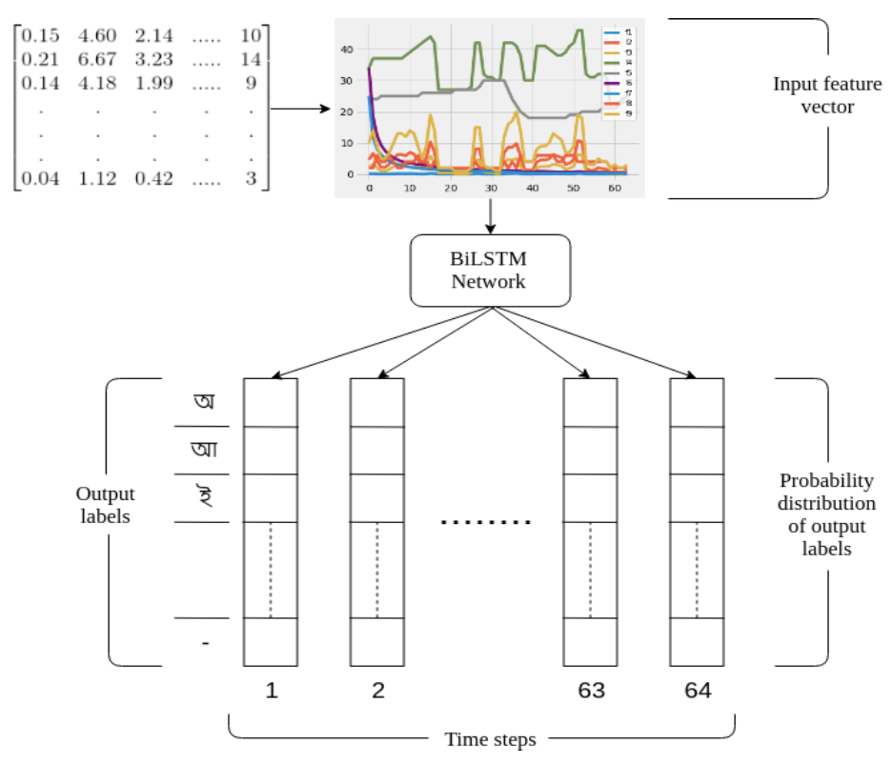
BiLSTM Network
The feature vectors are sequentially supplied to a BiLSTM network consisting of 3 layers each with 64 BiLSTM cells.
The network produces output based on the past sequence of features supplied to it.
Fig 4: The BiLSTM network.
5th International Conference on Internet of Things and Connected Technologies (ICIoTCT) 2020

Slide 12
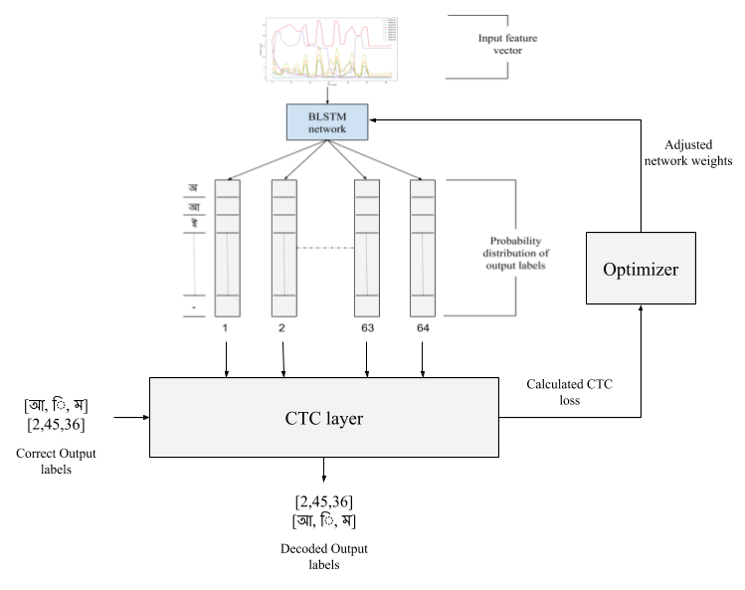
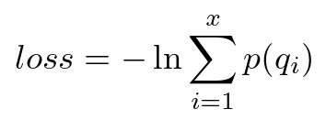
CTC Layer
The output of the BiLSTM network is supplied to the CTC layer.
The CTC layer acts differently for learning phase & recognition phase.
In learning phase, CTC loss is calculated using loss equation.
Fig 5: The CTC layer.
5th International Conference on Internet of Things and Connected Technologies (ICIoTCT) 2020

Slide 13
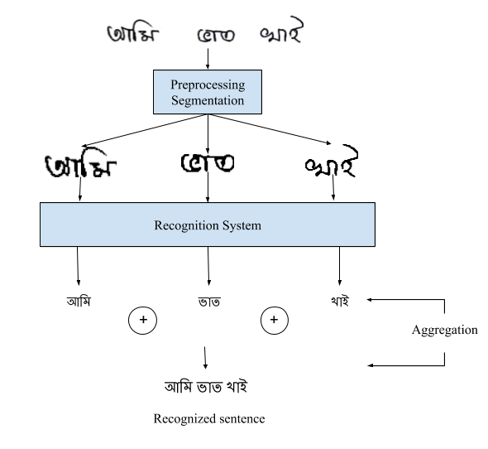
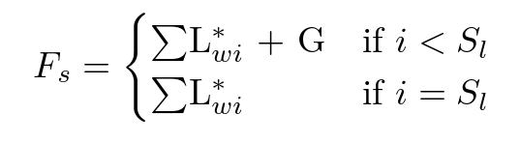
Sentence Recognition
Finally, the recognized words are aggregated to produce the final output sentence.
The words are aggregated:
Fig 6: Aggregation of words.
5th International Conference on Internet of Things and Connected Technologies (ICIoTCT) 2020

Slide 14
Results & Analysis
 | Training | Testing | Accuracy
Number of sentences | 300 | 150 | 92%
Number of words | 930 | 465
Avg. no. of words per sentence | 3.7 | 3.5
Writing styles | 15 | 15
Age range | 19-24 | 19-24
Dataset: 450 handwritten bangla sentences.
  1395 words
  15 different writing styles
Accuracy: 92%
Table 1: Dataset statistics.
5th International Conference on Internet of Things and Connected Technologies (ICIoTCT) 2020

Slide 15
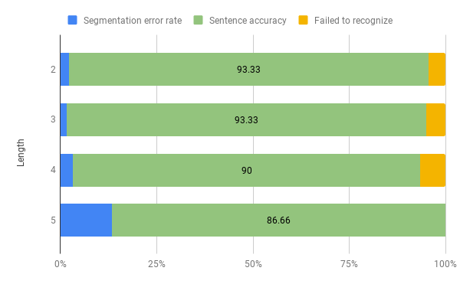
Results & Analysis (Contd.)
The accuracy of the system decreases as the length of the sentences increase.
Fig 7: Accuracy versus sentence length.
5th International Conference on Internet of Things and Connected Technologies (ICIoTCT) 2020

Slide 16














Results & Analysis (Contd.)
1) | 2) | 3)
4) | 5) | 6)
7) | 8) | 9)
10) | 11) | 12)
13) | 14) | 15)
Word accuracy: 100% , Sentence accuracy: 100%
Word accuracy: 96.66% , Sentence accuracy: 90%
Word accuracy: 91.66% , Sentence accuracy: 80%
Word accuracy: 100% , Sentence accuracy: 100%
Word accuracy: 100% , Sentence accuracy: 100%
Word accuracy: 100% , Sentence accuracy: 100%
Word accuracy: 100% , Sentence accuracy: 100%
Word accuracy: 100% , Sentence accuracy: 100%
Word accuracy: 100% , Sentence accuracy: 90%
Word accuracy: 100% , Sentence accuracy: 70%
Word accuracy: 100% , Sentence accuracy: 100%
Word accuracy: 100% , Sentence accuracy: 100%
Word accuracy: 100% , Sentence accuracy: 100%
Word accuracy: 79.63% , Sentence accuracy: 50%
Word accuracy: 100% , Sentence accuracy: 100%
Table 2: Performance of the system for various writing styles.
5th International Conference on Internet of Things and Connected Technologies (ICIoTCT) 2020

Slide 17
Results & Analysis (Contd.)
Table 3: Comparative analysis between BiLSTM-CTC & CNN at word level.
We performed a comparative analysis between the proposed technique & CNN.
The CNN architecture consisted of 3 convolution, 2 max pooling, 2 fully connected and a dropout layer.
Architecture | Total words | Correctly predicted | Word accuracy
BiLSTM-CTC | 465 | 378 | 81.29%
CNN | 465 | 351 | 75.48%
5th International Conference on Internet of Things and Connected Technologies (ICIoTCT) 2020

Slide 18
Conclusion
This work presents a deep neural network based technique that can recognize Bengali handwritten sentences with 92% accuracy.
This architecture enables the system to recognize words without segmenting them into constituent characters.
Future Improvements:
The overall accuracy can be improved by increasing the variation of different writing styles as well as including sentences with a wide range of words in our dataset.
The presented implementation can be extended to recognize handwritten paragraphs by including more steps in preprocessing and segmentation phases.
5th International Conference on Internet of Things and Connected Technologies (ICIoTCT) 2020

Slide 19
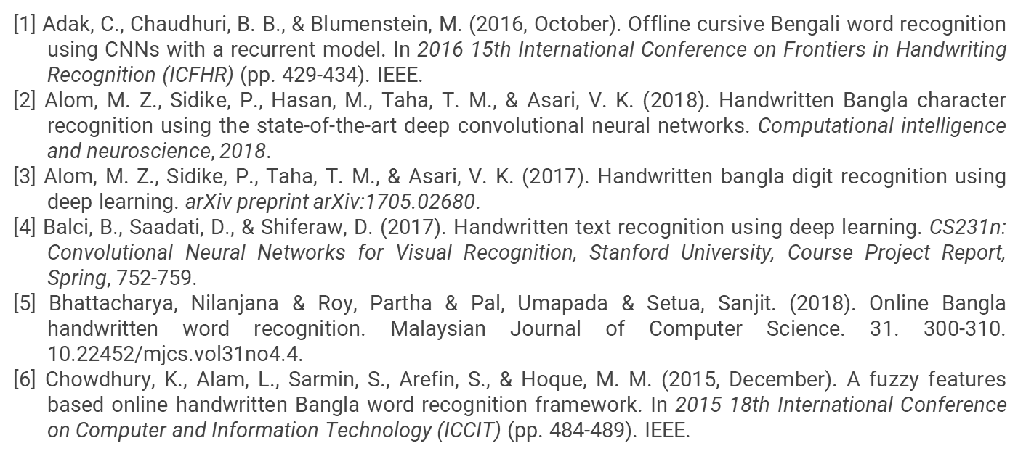
References
5th International Conference on Internet of Things and Connected Technologies (ICIoTCT) 2020

Slide 20
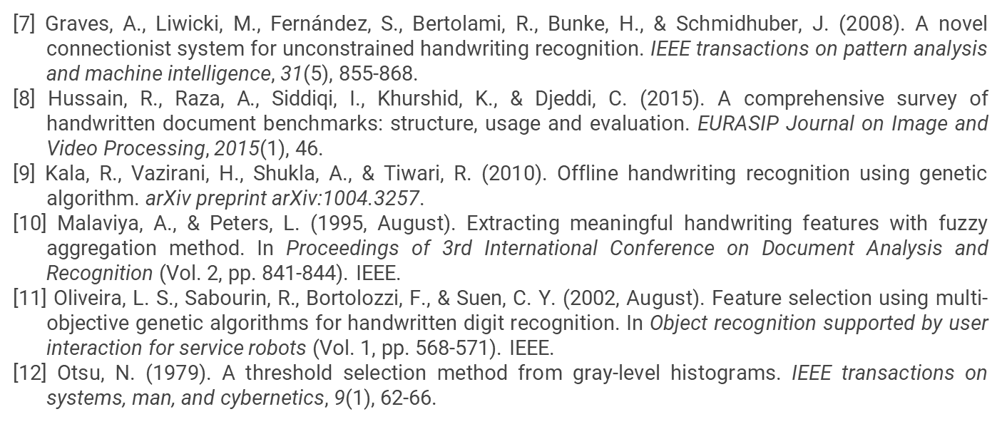
References
5th International Conference on Internet of Things and Connected Technologies (ICIoTCT) 2020

Slide 21
Thank you
Feel free to ask questions

